Slide 1

Introduction to making music with python FoxDot for beginner
Ngatatue V Mate
ngatatuemate@gmail.com
Github: Ngatatue/Introduction-to-FoxDot
Twitter: @ngatatuemate

Slide 2
Overview
About Me
What is live coding?
Existing live coding languages
FoxDot Environment
Basic instruction
Practical examples.

Slide 3
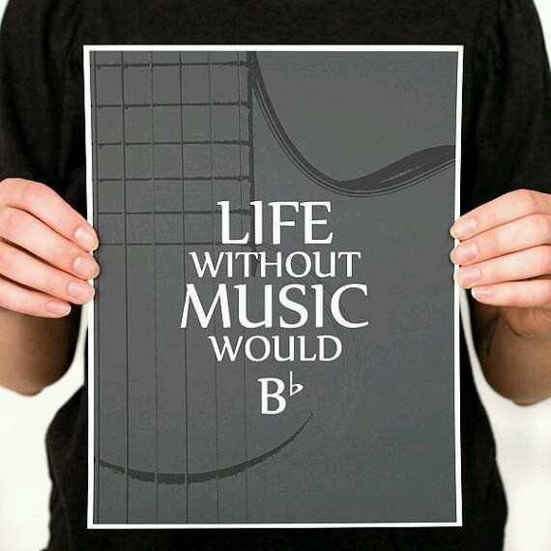
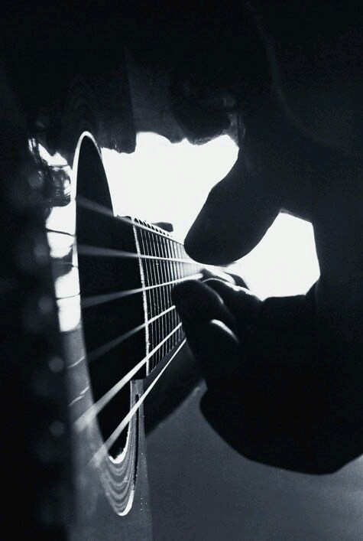
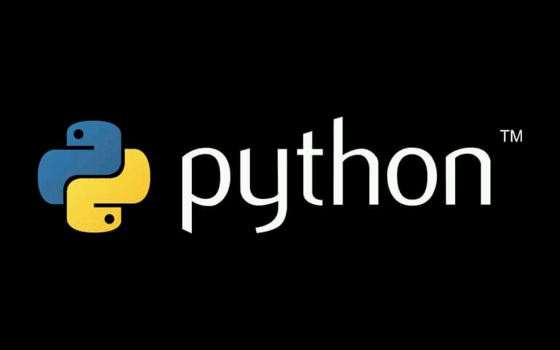
About me

Slide 4
What is live coding?
“Live coding is a new direction in electronic music and video, and is getting somewhere interesting. Live coders expose and rewrite the innards of software while it generates improvised music”
toplap.org

Slide 5
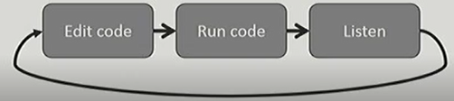
What is live coding?
Live composition as performance
The use of code to describe rules for music
Coding where the programmer interacts with code while the program is running.

Slide 6



Existing live coding languages

Slide 7
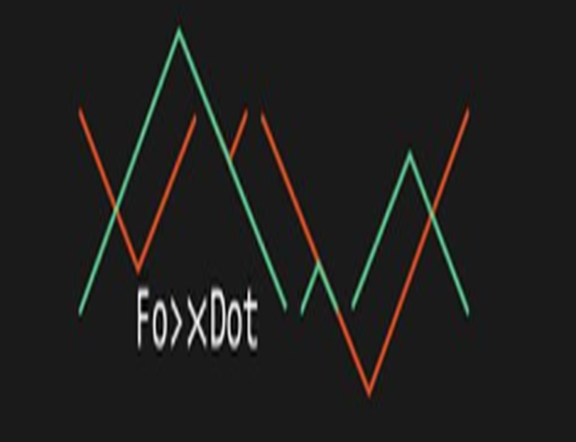
FoxDot environment
Focuses on musical patterns
Clean
Easy to write, easy to read
Object oriented live coding
Accesible states
Reactive and dynamic objects

Slide 8
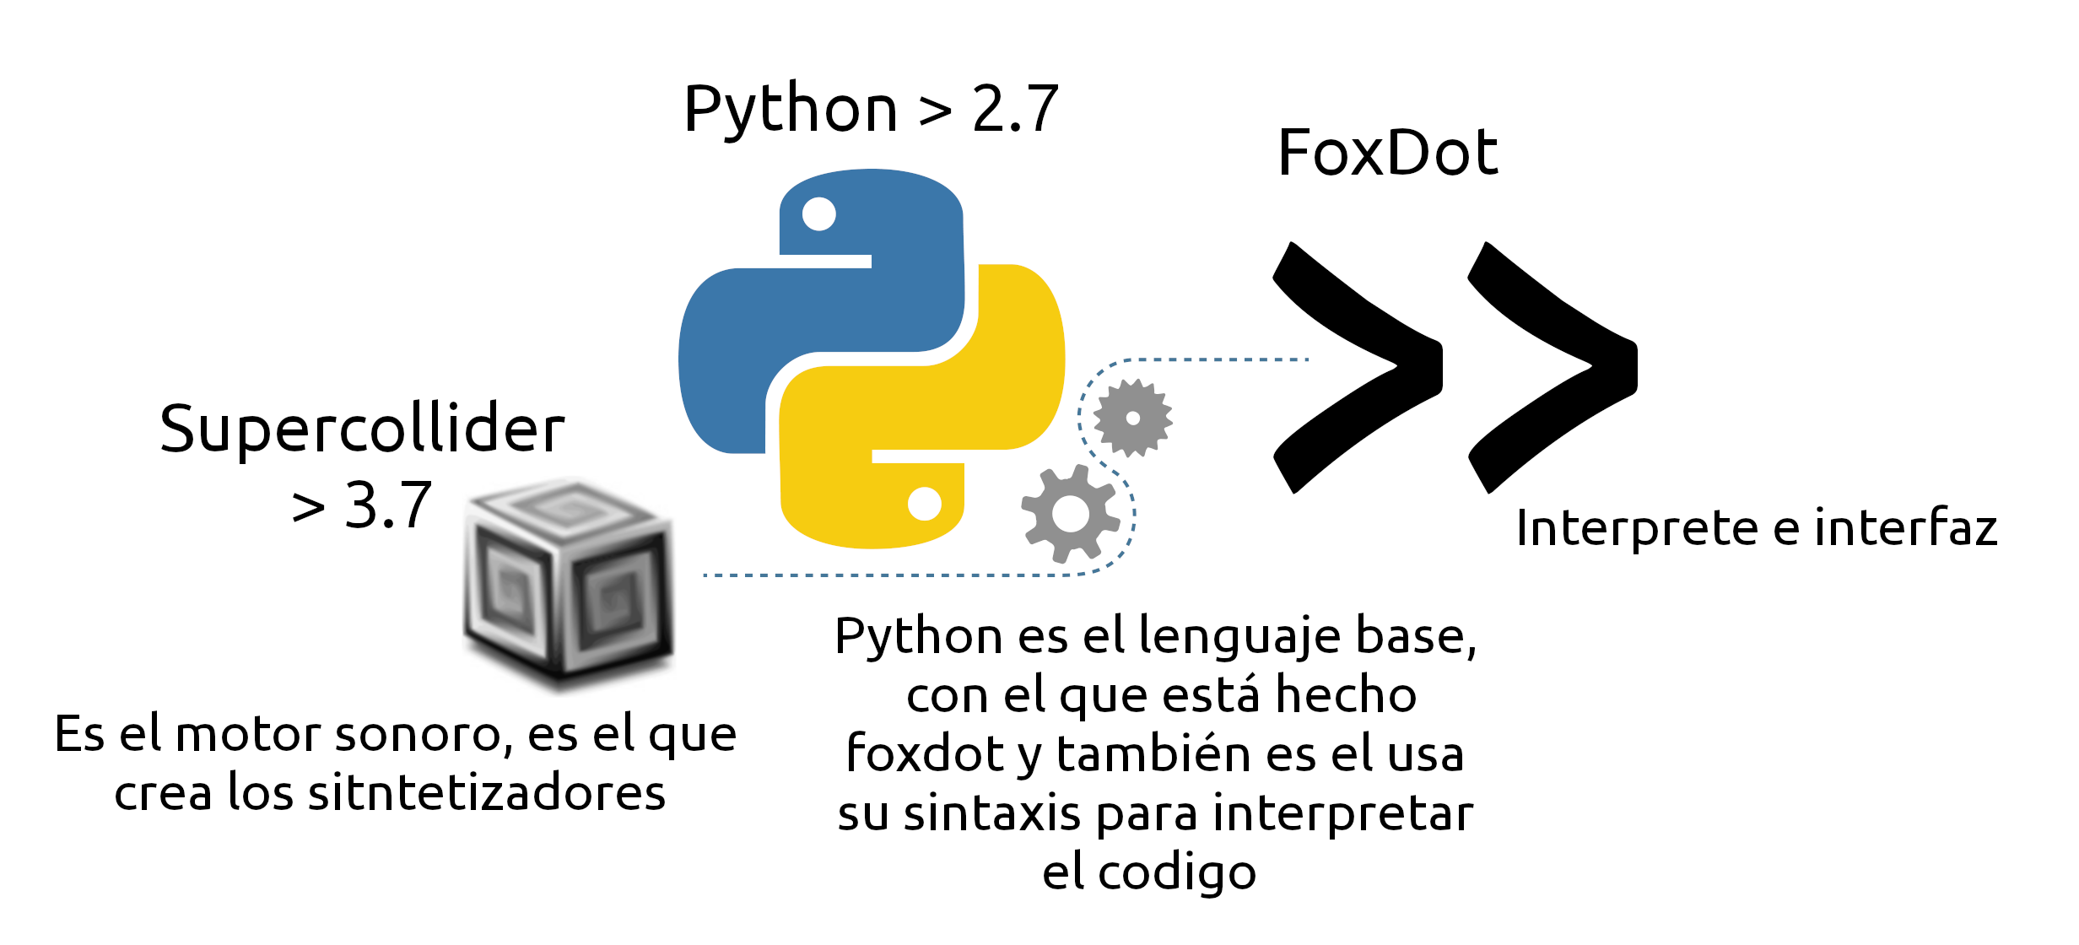
FoxDot environment

Slide 9
FoxDot environment
Player objects
All two character variable instantiated at run-time
Generate music
Name of the “instrument” or “SynthDef”
Pitch, Duration and parameters for filters
Given instruction using the >> syntax
P1 >> pads([0,1,2,3], dur=[1,1/2,1/2], oct=(4,5), room=1)

Slide 10
FoxDot environment
Sample Player
Takes a string as its first argument instead of pitches
Each sample is mapped to a character
String is parsed to create rhythm
[square] brackets plays multiple samples in succession
(round) brackets alternates the sample played
{curly} braces plays one sample at random

Slide 11
FoxDot environment
Pattern objects
Contains types that allow arithmetic operations and modular indexing
E.g P[0,1,2,3] + [2,4] -> P[2,5,4,7]
Methods for manipulating order
E.g palindrome, rotate and stretch
Predefined functions for generating useful patterns of numbers
PDur generates durations for rhythms

Slide 12
FoxDot environment
Time dependent variable
Variables that change value based on time
Reative, changes propagate to variables that depend on it
>>> A = var([0,1],8)
>>> B = A+2
>>> print(A,B)
0,2
>>> A.update([2,4])
>>> print(A,B)
4,6

Slide 13
FoxDot environment
Player states
Algorithmically altered in time
P1 >> pluck([0,1,2,3]).every(4, “reverse”)
Can be referenced by other players
Dynamic and versatile
If b1.dur = p1.dur and p1.dur changes, so does b1.dur

Slide 14
FoxDot environment
Global clock
Handles all the musical events
Can schedule functions in future
Functions can call themselves in the future while you edit them
Temporal recursion
How the player objects work

Slide 15
Practical examples
Installation
Exercises

